Slide 1
MIS 3301 Intro. to Business Programming Logic
Lists & Tuples
Part 4 - Passing & Returning Lists to Functions
Mrs. Nancy G. Sánchez

Slide 2
Passing & Returning Lists to Functions

Slide 3
Passing a List
def main():
depts = ['ISBA', 'MKT', 'FIN', 'MGT', 'ACC']
#pass a list to a function
my_funct(depts)
def my_funct(dept_list):
print(dept_list)
main()
['ISBA', 'MKT', 'FIN', 'MGT', 'ACC']
['ISBA', 'MKT', 'FIN', 'MGT', 'ACC']

Slide 4
Review: Passing Immutable Objects
[Review from Ch5 – Functions] - When we pass an immutable object (e.g. strings, ints, floats, bools), the calling function (e.g. main) will NOT be aware when the called function (e.g. my_function) has changed the passed value because a new object is created.
Passing Immutable arguments
def main():
a = 10
my_function(a)
print('a:', a)
def my_function(x):
x = 99
main()
a: 10
Notice that the value of “a” in main
was NOT updated.
Recall, because integers are immutable, a new object is created here.
(this is true for strings & floats too)

Slide 5
New: Passing Mutable Objects
However, when we pass a mutable object (e.g. list), the calling function (e.g. main) will be aware of any changes that occurred to this object in the called function (e.g. my_function) because it is the same object.
Recall, you can use the id() function to check the address of each object.
Passing Mutable arguments
def main():
a = [10,20,30]
my_function(a)
print('a:', a)
def my_function(x):
x.append(40)
main()
This is also true when using:
x.remove(40) **
x[0] = 40
However, this creates a new object
x = [100,900]
a: [10, 20, 30, 40]
Notice that the value of “a” in main
WAS updated.
Because lists are mutable, the same object is updated here.
** or any of the List Methods
Adding values: append(), extend(), insert()
Removing values: clear(), remove(), pop()
Changing the order: sort(), reverse()

Slide 6
Returning a List
def main():
#Receive a list from a function
num_list = gen_numbers()
print(num_list)
def gen_numbers():
nums = [] #an empty list
for i in range(10, 50, 10):
nums.append(i)
#Return the list
return nums
main()
Notice this list wasn’t created in main()
[10, 20, 30, 40]
Alternate gen_numbers()
… it’s created in gen_numbers() & then returned
def gen_numbers():
nums = [0]*4 #4 elements w/0's
i = 0
while i < len(nums):
nums[i] = (i+1)*10
i += 1
#Return the list
return nums

Slide 7
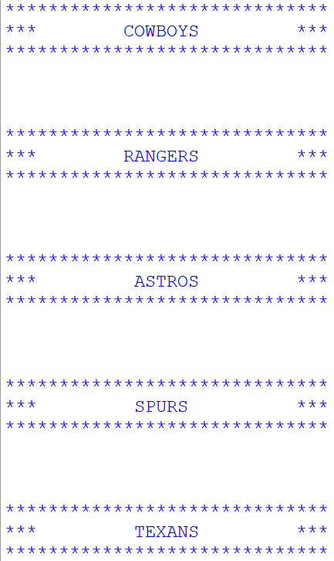
Exercise 6 – Passing a List
Copy the starter code below and save it as Ch7-Ex06-PassingList.py
Produce the output on the right.
#Ch7-Ex04-PassingList.py
def main():
'Cowboys', 'Rangers', 'Astros', 'Spurs', 'Texans'
#call the function & pass this list
def display_team_banners(_____): #use a different variable name for the list
Loop here
print('*'*30)
print('***', ________,'^22'), '***')
print('*'*30)
print('\n\n')
main()

Slide 8
Exercise 7 – Passing a Single Element
Copy the previous program and save it as Ch7-Ex07-PassingAn Element.py
Produce the output on the right.
Update the banner function to display only one team.
In Main:
Prompt the user for a team
Invoke the display banner function (but only if the team entered is a valid team in the list). If it is not, display a message like “Giants not found”.

